Slide 1



VEHICLE SERVICE MANAGEMENT SYSTEM
by : podila sravya
Email: podilasravya7052@gmail.com

Slide 2
PROJECT OVERVIEW
Vehicle Service Management System
microservices-based web application for automobile service centers.
Problem Statement:
  Manual tracking of service requests and vehicle history
  Inefficient technician scheduling and service bay allocation
  Delayed spare parts management
  Limited visibility into workload and revenue
Solution:
A full-stack enterprise application that provides:
  End-to-end service request lifecycle management
  Role-based dashboards for Admin, Manager, Technician, and Customer
  Automated billing and invoice generation
  Real-time email notifications
  Inventory and spare parts management
  Reports and analytics dashboard

Slide 3
MICROSERVICES ARCHITECTURE
8 Microservices:
  Config Server (8888) - Centralized configuration
  Eureka Server (8761) - Service discovery
  API Gateway (9090) - Entry point, JWT authentication, routing
  User Service - Authentication, user management
  Vehicle Service - Vehicle registration
  Inventory Service - Spare parts, part requests
  Service Request Service - Service lifecycle, billing, bays
  Notification Service - Email notifications
Inter-Service Communication:
  Feign Clients
  RabbitMQ

Slide 4
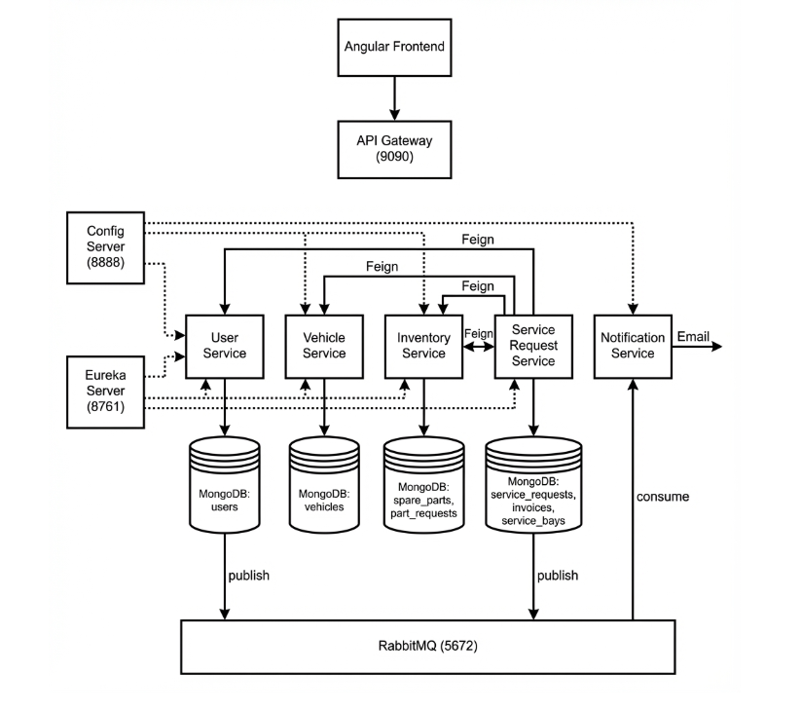
MICROSERVICES ARCHITECTURE

Slide 5
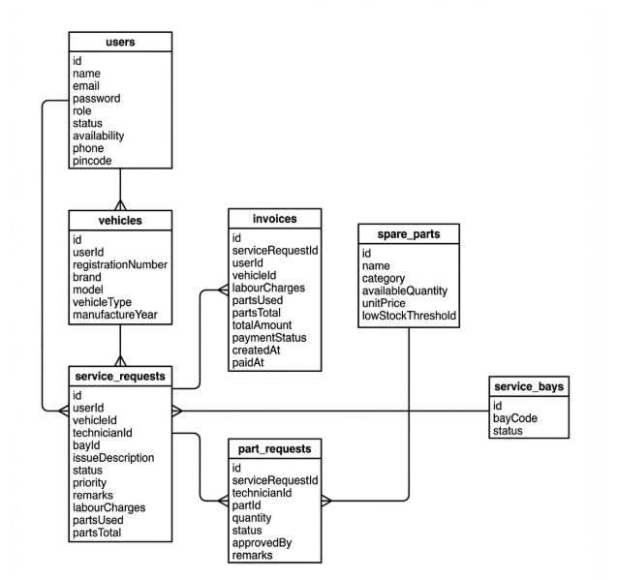
DATABASE SCHEMA
Service | Collections
User Service | users
Vehicle Service | vehicles
Inventory Service | spare_parts, part_requests
Service Request Service | service_requests, invoices, service_bays

Slide 6
USER ROLES & RESPONSIBILITIES
ADMIN :
Approve/Reject Registrations , Manage Users ,View Reports
MANAGER:
Assign Technicians , Manage Bays , Approve Parts , Close Services ,Generate Invoices
TECHNICIAN :
View Tasks , Update Status , Request Parts , Add Used Parts
CUSTOMER :
Register Vehicles , Create Requests , Track Status , View History , Pay Invoices

Slide 7
SERVICE REQUEST WORKFLOW
Lifecycle Flow:
PENDING → ASSIGNED → IN_PROGRESS → COMPLETED → CLOSED
Step-by-Step:
  Customer creates service request with vehicle & issue details
  Manager assigns technician and service bay
  Notification sent to customer (email via RabbitMQ)
  Technician starts work, updates status to IN_PROGRESS
  Technician requests spare parts if needed
  Manager approves part requests
  Technician completes service, adds used parts
  Manager closes service request
  System generates invoice with labour + parts total
  Notification sends invoice to customer
  Customer pays invoice

Slide 8
KEY FEATURES IMPLEMENTED
Module | Features
Authentication | JWT login, Role-based access, Password change
Vehicles | Register, View history, Multiple vehicles per customer
Service Requests | Create, Assign, Track status, Priority levels
Technician Management | Workload tracking, Availability status
Service Bays | Bay allocation, Status management
Inventory | Parts catalog, Stock tracking, Part requests
Billing | Auto invoice generation, Payment tracking
Notifications | Email on registration, service updates, invoices

Slide 9
CI/CD PIPELINE
Jenkins Pipeline Stages:
GitHub → Build & Test → SonarCloud → Docker Build → Docker Compose
  Checkout - Pull code from GitHub
  Build & Test - Maven verify, JUnit tests
  SonarCloud - Code quality analysis, coverage reports
  Docker Build - Build images for all services
  Docker Compose - Deploy all containers
Code Quality:
  Unit Tests: JUnit 5, Mockito
  Coverage: JaCoCo (90%)
  Analysis: SonarCloud

Slide 10
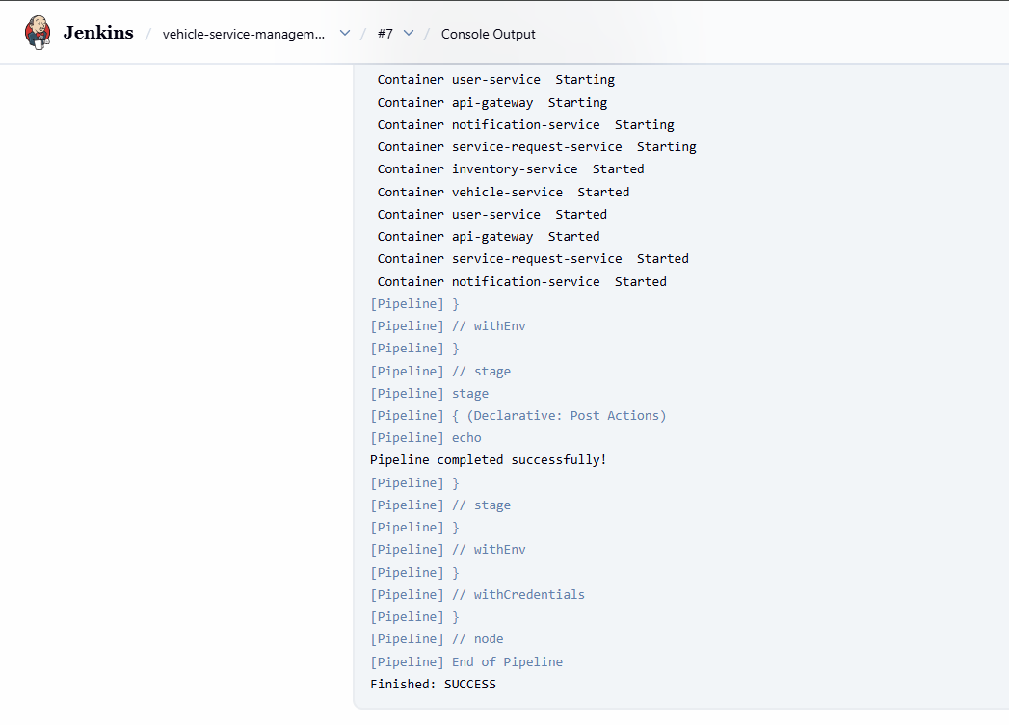
CI/CD PIPELINE

Slide 11
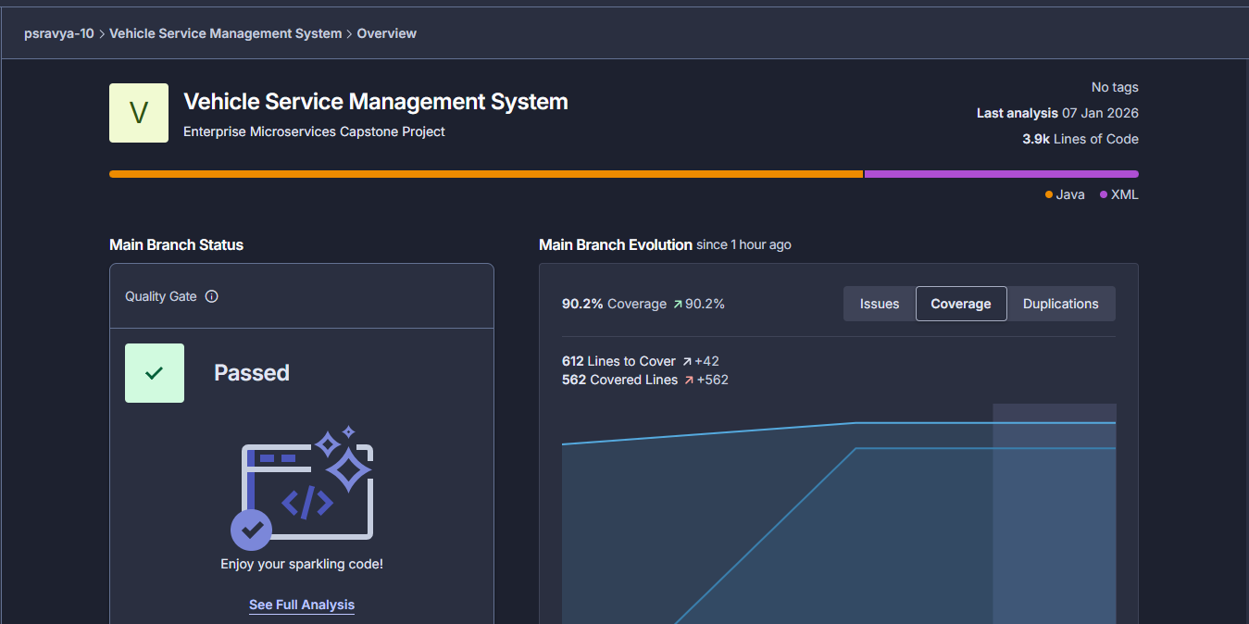
SONARQUBE

Slide 12
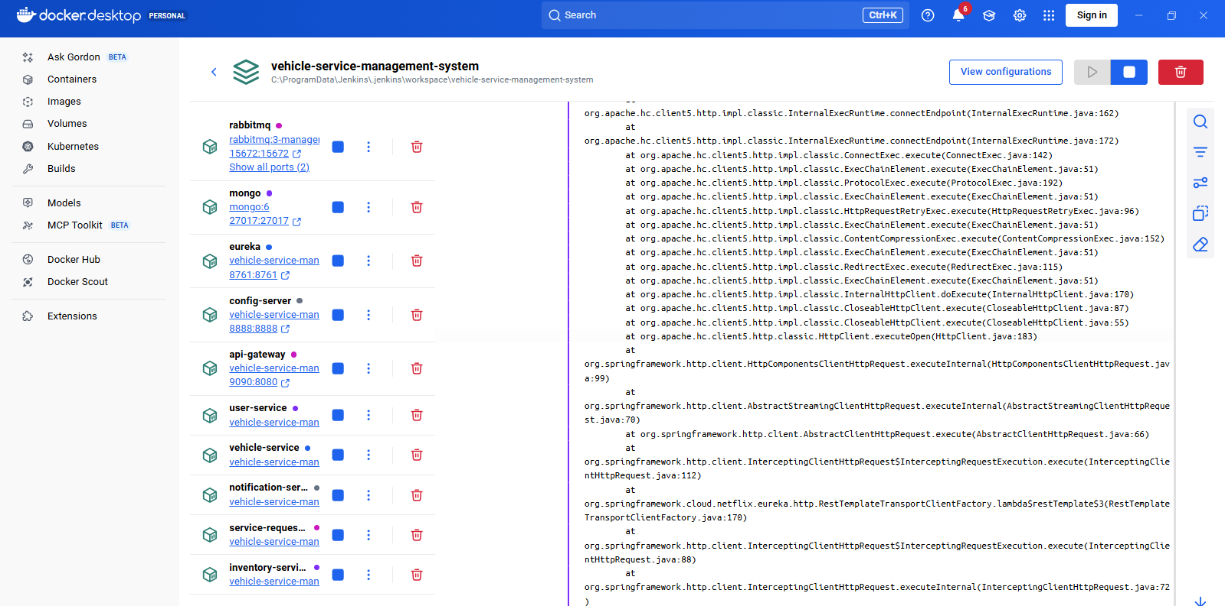
DOCKER

Slide 13
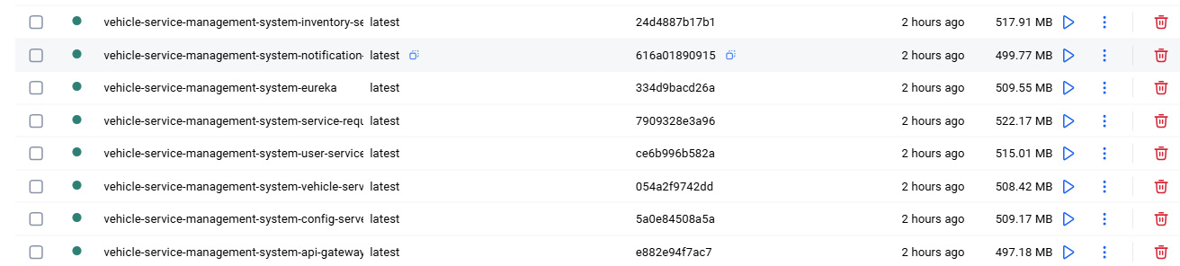
DOCKER

Slide 14
SUMMARY
  Microservices Architecture with 8 independent services
  Secure JWT-based Authentication & Role-Based Access Control
  Complete Service Lifecycle Management (Pending → Closed)
  Real-time Email Notifications via RabbitMQ
  Automated Billing & Invoice Generation
  Spare Parts Inventory Management
  CI/CD Pipeline with Jenkins, Docker & SonarCloud
  90%+ Code Coverage with JUnit & Mockito
Application Lifecycle:
REQUESTED → ASSIGNED → IN_PROGRESS → COMPLETED → CLOSED → PAID

Slide 15

THANK YOU

